Slide 1
Artifacts in DevOps CI/CD Pipeline

Slide 2
Learning Outcomes
Understand what artifacts are.
Understand why artifacts are important.
Differentiate source code from artifacts.
Learn different artifact types used in various technologies.
Build and archive artifacts using Jenkins.
Understand artifact repositories.

Slide 3
Artifact
An artifact is the generated output of the software build process that is ready for testing, deployment, or distribution.
Examples
Java → JAR
Spring Boot → Executable JAR
Python → Wheel (.whl)
React → build folder
Android → APK
Docker → Docker Image

Slide 4
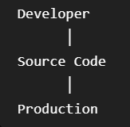
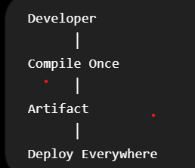
Why Do We Need Artifacts?
Without artifacts
With artifacts
Every server builds separately.
Problems
Different versions
Compilation errors
Dependency mismatch
Slow deployment
Advantages
Faster deployment
Same build everywhere
Easy rollback
Version control
Reliable deployments

Slide 5
Source Code vs Artifact
Source Code | Artifact
Human readable | Machine executable
Editable | Not edited
.java | .jar
.py | .whl
React files | build folder
Android Java/Kotlin | APK

Slide 6
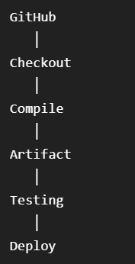
Where Are Artifacts Used?
Every stage after Build uses the artifact.

Slide 7
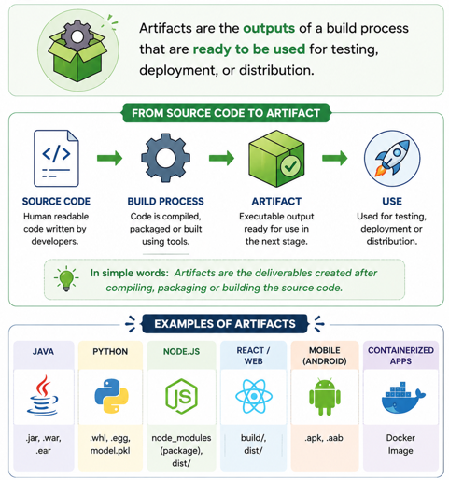
Understand what artifacts are

Slide 8
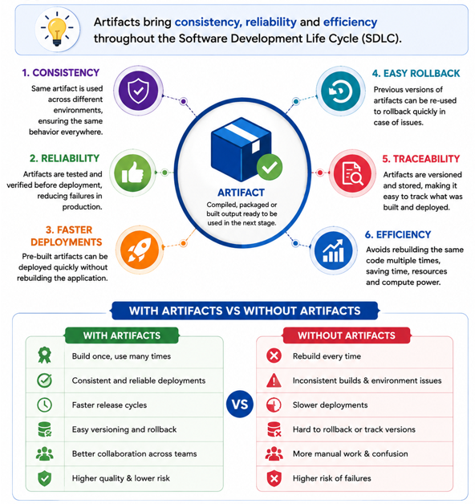
Understand why artifacts are important

Slide 9
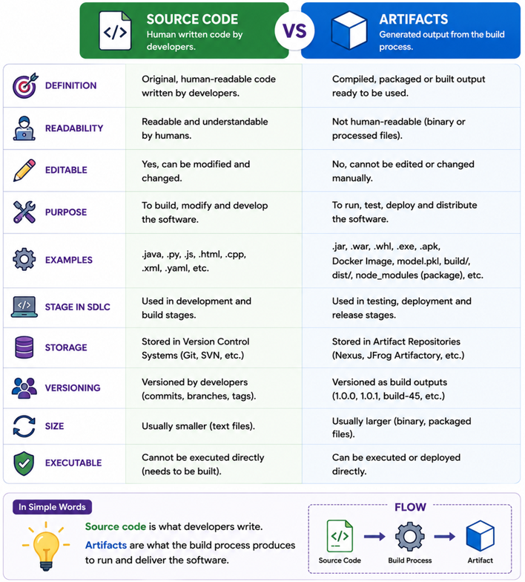
Differentiate source code from artifacts

Slide 10
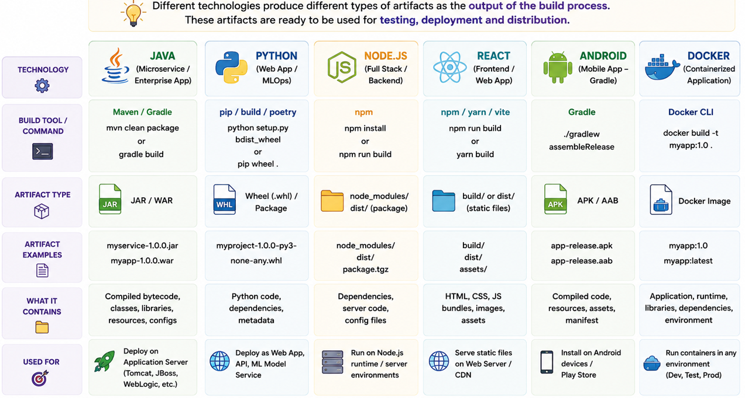
Learn different artifact types used in various technologies

Slide 11
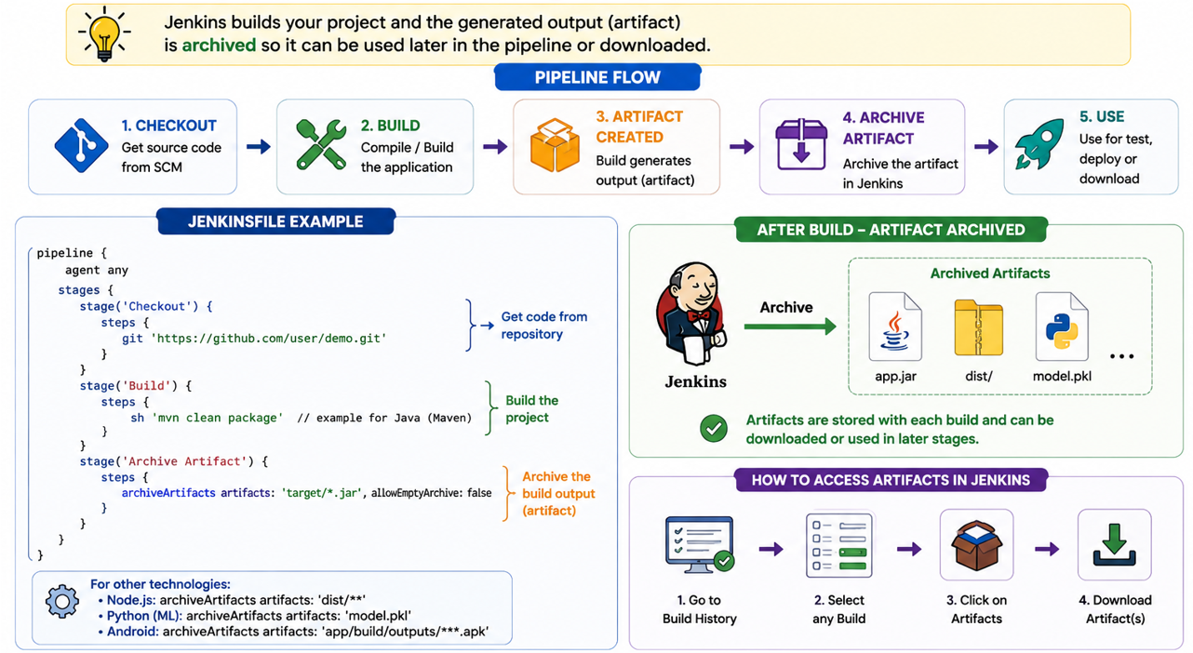
Build and archive artifacts using Jenkins

Slide 12
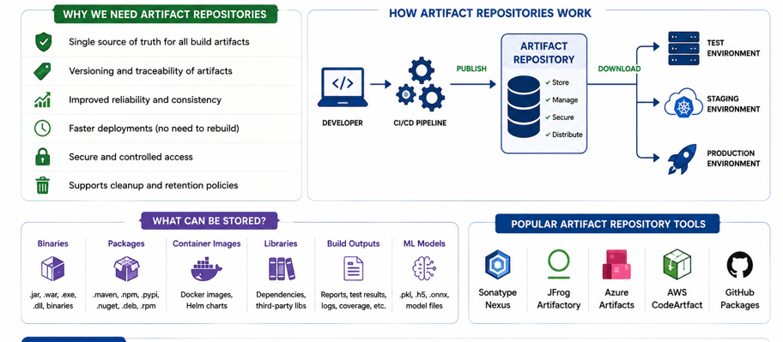
Understand artifact repositories

